Slide 1
Predicting Vegetarian User Purchase Behavior
A Market Basket Analysis Approach

Slide 2
Business Problem
Stakeholder is Instacart and stores
Understand vegetarian user purchase patterns from Instacart
Predict if a new order is a first-time purchase or a re-order
If first time purchase offer them incentives and recommendations
If reorder offer incentives and track purchasing habits
Introduce product recommendations and promotions for vegetarians
Classification using Supervised Machine Learning

Slide 3
Data Understanding
Data Source :https://www.kaggle.com/datasets/psparks/instacart-market-basket-analysis
Publicly available on Kaggle
Contains over 5 million instances of orders made via Instacart grocery shopping app
Includes information on products, store aisles, and departments
Indicates the frequency of order placements
Specifies whether orders were reordered or not

Slide 4
Data Exploration and Cleaning
Merged four datasets (products, aisles, orders, departments)
Filtered data for food-related orders
Handled missing values in "days_since_prior_order“
Used pandas “fillna()” method to replace NaNs with 0.
Slightly imbalanced data (More re-orders than first-time orders)

Slide 5
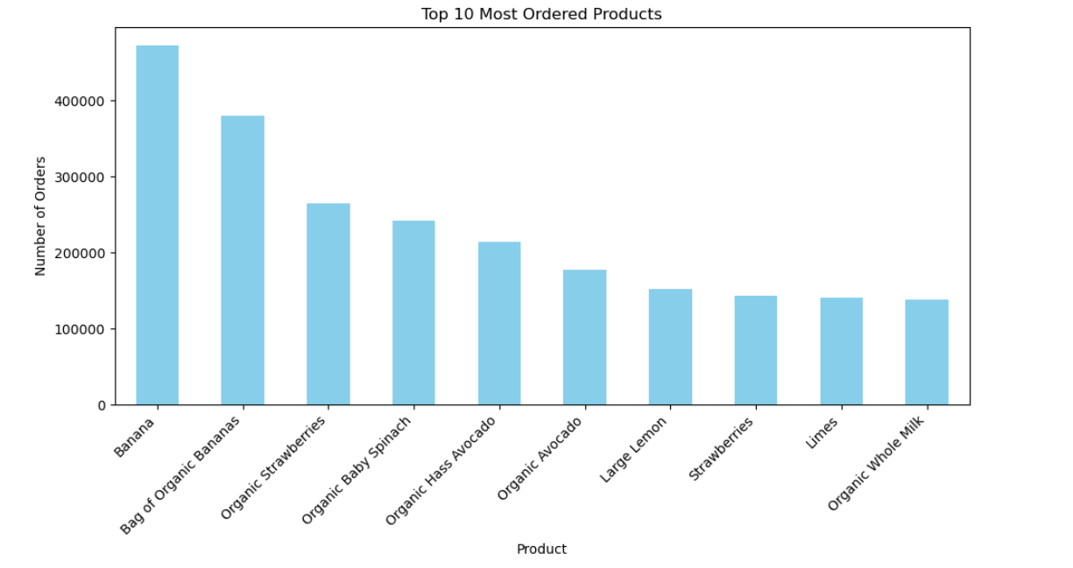
Exploratory Data Analysis
Top 10 Most Ordered Products

Slide 6
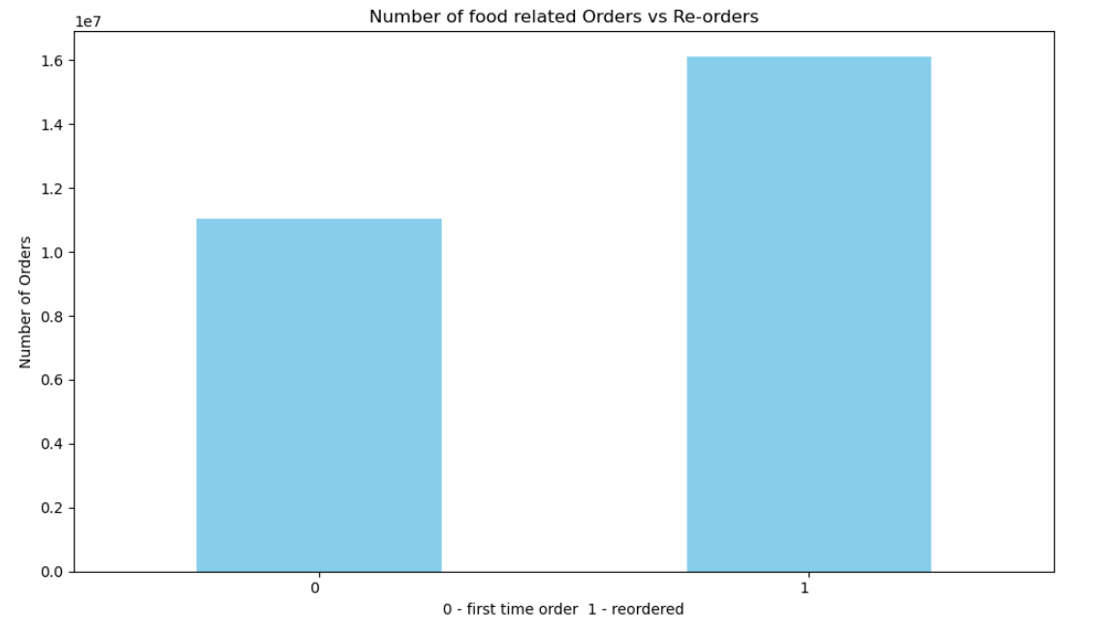
Exploratory Data Analysis (contd.)
First Time Order vs. Re-order of Products

Slide 7
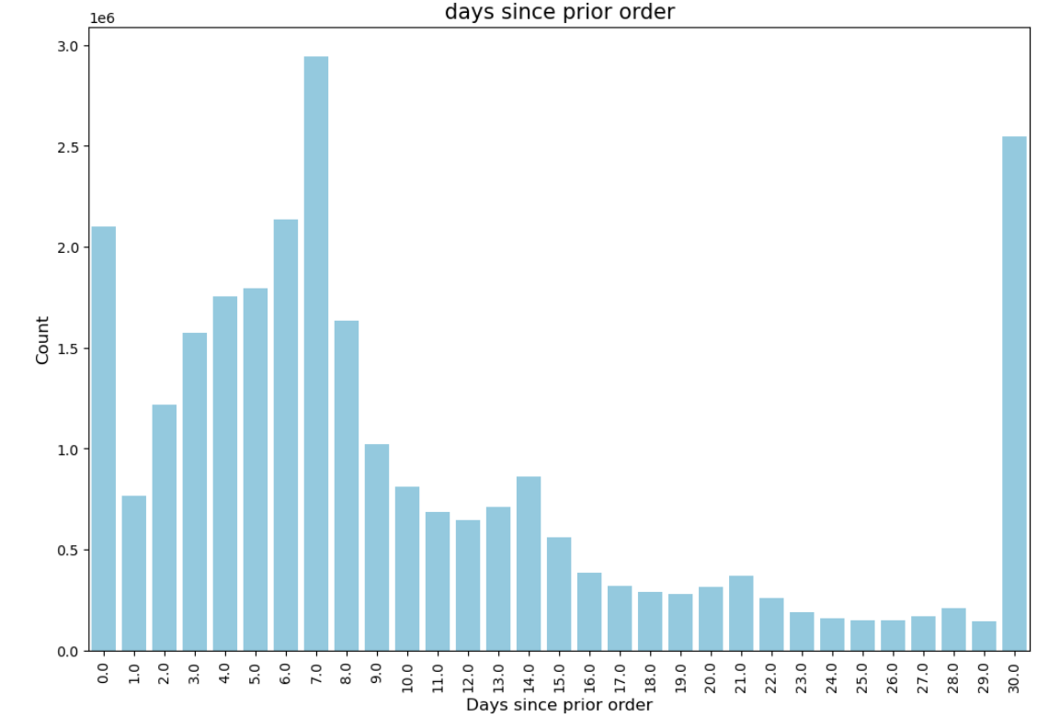
Exploratory Data Analysis (contd.)
Distribution of Days Since Prior Order

Slide 8
Exploratory Data Analysis (contd.)
Distribution of Days Since Prior Order
Most frequent between 4-8 days

Slide 9
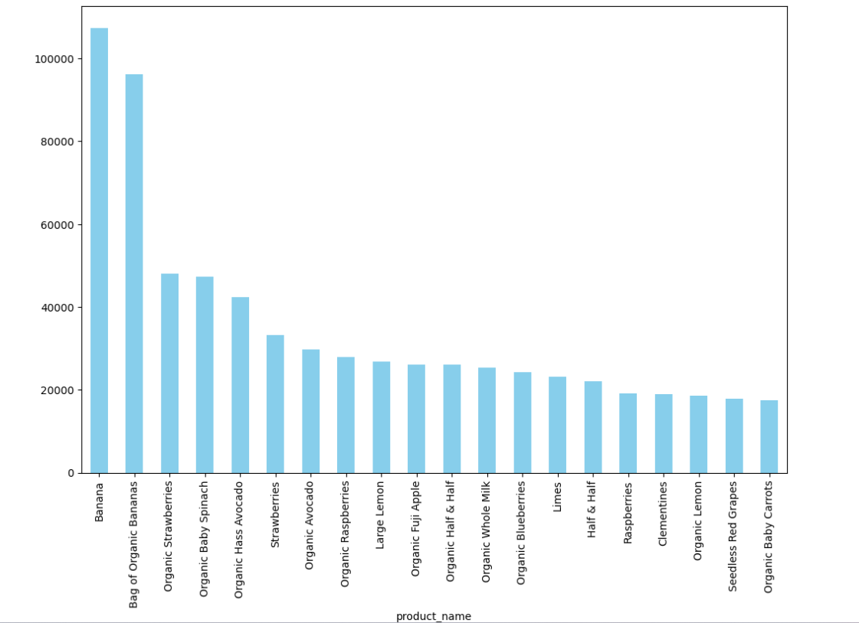
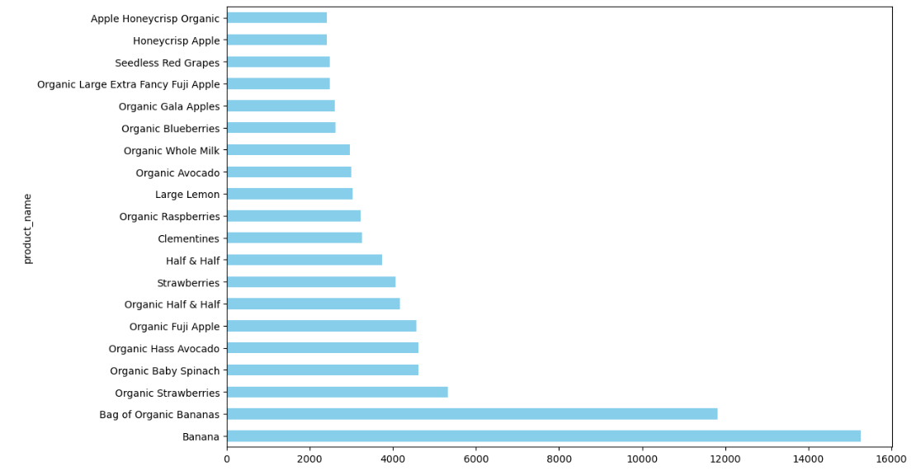
Vegetarian User Analysis
Top 10 Products Ordered by Vegetarian Users
Top 20 Products Re-ordered Weekly by Vegetarian Users

Slide 10
Model Development
Target Feature: “Reordered”
Dropped non-numeric columns for model training
Split the data into 70% training and 30% testing
Trained and evaluated 7 ML Models:
Logistic Regression
Decision Tree Classifier
XGBoost, Random Forest
Naïve Bayes Classifier
Voting Classifier
Stacking Classifier

Slide 11
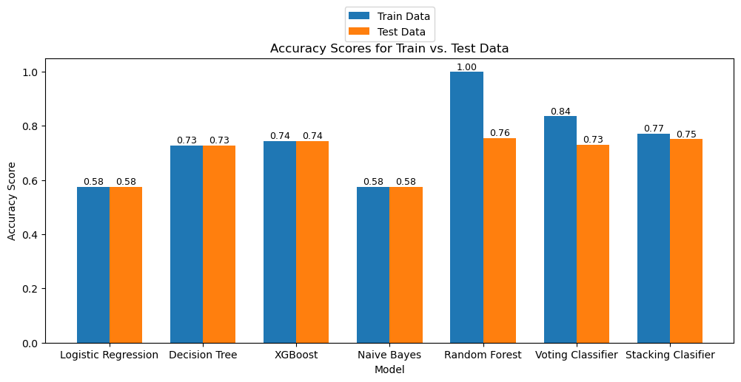
Model Results

Slide 12
Hyperparameter Tuning
Hyperparameter tuning of XGBoost, Naïve Bayes, Logistic Regression
XGBoost improved test accuracy (74% to 76%).
Naïve Bayes improved test accuracy (58% to 68%)
Logistic regression improved test accuracy (58% to 70%)

Slide 13
Conclusion
Aimed to classify vegetarian users' first-time orders versus re-orders using different ML techniques.
Merged and preprocessed four datasets—products, aisles, orders, and departments—and conducted exploratory data analysis to unveil ordering patterns and trends.
Employed various machine learning models, including Stacking Classifier, Random Forest, Logistic Regression, and XGBoost, Naïve Bayes, Decision Tree, achieving accuracies ranging from 64% to 75%.
Tuned XGBoost, resulting in an accuracy improvement from 74% to 76%, Naïve Bayes 63% to 66% and logistic regression 58% to 70%.
The analysis offers actionable insights for understanding user behavior in online food ordering platforms, paving the way for predictive modeling to enhance customer experience and operational efficiency.

